Slide 1

Department of Electrical Engineering
Sanjivani Rural Education Society’s Sanjivani College of Engineering , Kopargaon - 423 601
(An Autonomous Institute, Affiliated to Savitribai Phule Pune University, Pune)
NAAC ‘A’ Grade Accredited, ISO 9001:2015 Certified
Project:-Electrochemical Biosensor
UNDER GUIDANCE :-Prof.M.V.Kulkarni
Presented by:-
Roll No.
Name
Roll No.
Name
1 Gaikwad Sayali
2 Landge Payal
3 Gholap Harshad
4 Yuvare Atul
5 Kurasane Shivam
6 Bornare Bablu
7 Shaikh Aliba
8 Pawar Shradhha
10 Fatangare Archana
Department Of Electrical Engineering, Sanjivani COE, Kopargaon

Slide 2
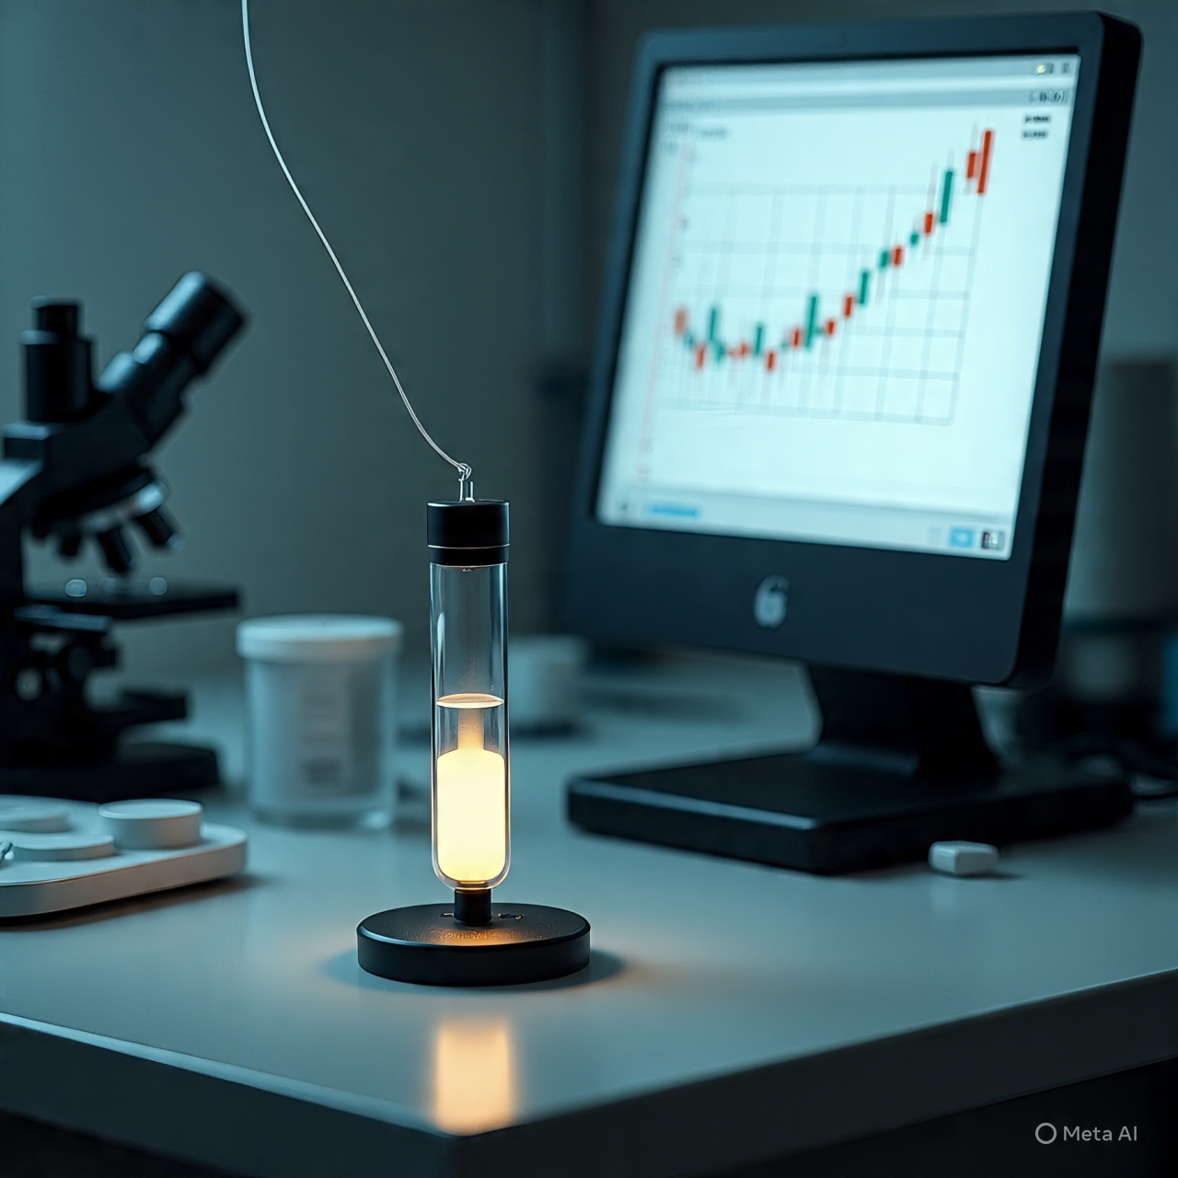
INTRODUCTION
Electrochemical Biosensor:-
A device that uses a biological element (like enzyme, antibody, or DNA) and an electrode to detect a specific substance.It converts the biological reaction into an electrical signal that can be measured.
Department Of Electrical Engineering, Sanjivani COE, Kopargaon

Slide 3
TYPE OF BIOSENSOR
Type of Biosensor | Description | Example
Electrochemical Biosensor | Measures electrical signals from biochemical reactions | Glucose sensor for diabetes monitoring
Optical Biosensor | Uses light (absorbance, fluorescence, etc.) to detect biological interactions | DNA microarray for genetic analysis
Piezoelectric Biosensor | Detects changes in mass or mechanical vibrations | Pathogen detection in food samples
Department Of Electrical Engineering, Sanjivani COE, Kopargaon

Slide 4
TYPE OF BIOSENSOR
Thermal Biosensor | Measures heat changes from biochemical reactions | Enzyme-based urea sensor
Immunosensor | Uses antibodies to detect specific antigens | COVID-19 rapid antigen test
Enzymatic Biosensor | Uses enzymes to catalyze reactions and detect analytes | Lactate sensor in sports medicine
Department Of Electrical Engineering, Sanjivani COE, Kopargaon

Slide 5
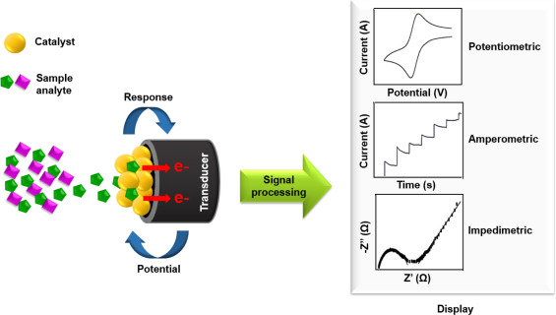
Types Of Electrochemical Detection
Amperometric:-Current-based,highly sensitive.
Potentiometric:-Voltage-based, ideal for ion detection.
Conductometric Conductivity:-based, simple and fast.
Voltammetric:-Voltage sweep for detailed analysis.
Impedimetric:-Measures resistance and capacitance changes.
Department Of Electrical Engineering, Sanjivani COE, Kopargaon

Slide 6
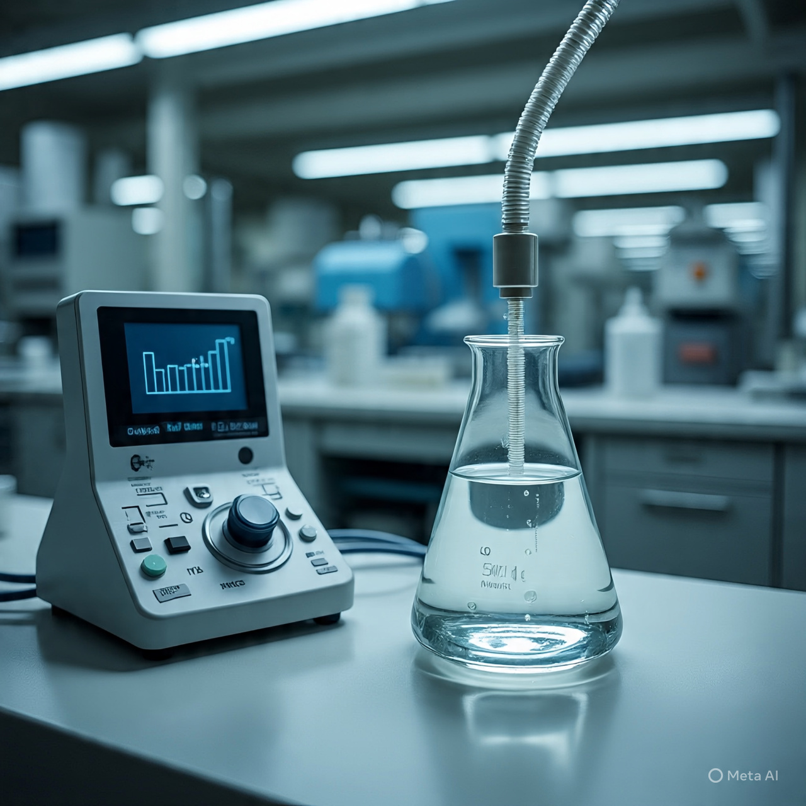
Application
🏥 Medical Use
Check blood sugar (glucose meter).
Detect cancer markers, cholesterol, uric acid, lactate.
Find viruses/bacteria (HIV, COVID-19, TB).
🌍 Environmental Use
Detect pesticides, herbicides, heavy metals, phenols, hormones (like estradiol).
Monitor pollutants in wastewater.
Check air and soil quality.
Department Of Electrical Engineering, Sanjivani COE, Kopargaon

Slide 7
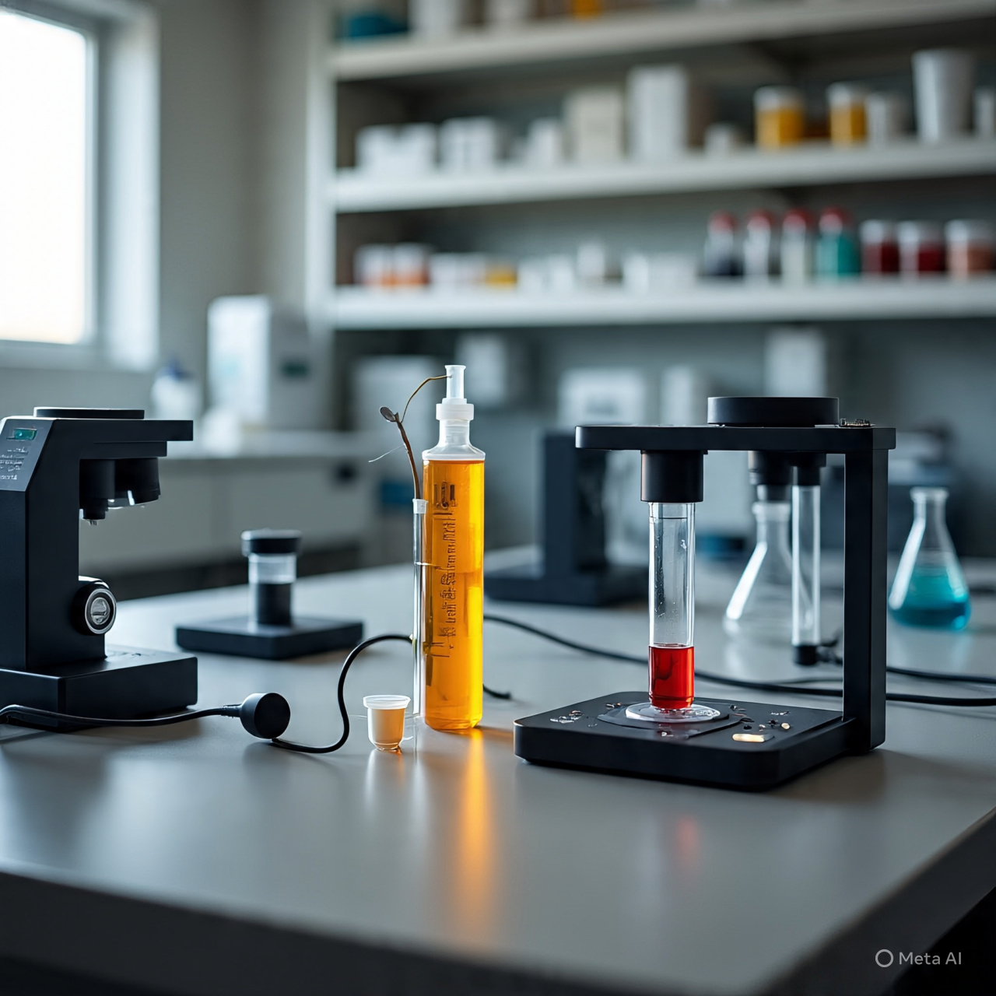
Application
🍎 Food Use
Detect harmful germs (Salmonella, E. coli).
Test freshness of fish/meat.
Check additives, toxins, and GMOs
⚙️ Industrial Use
Control fermentation in industries.
Monitor enzyme activity.
Department Of Electrical Engineering, Sanjivani COE, Kopargaon

Slide 8
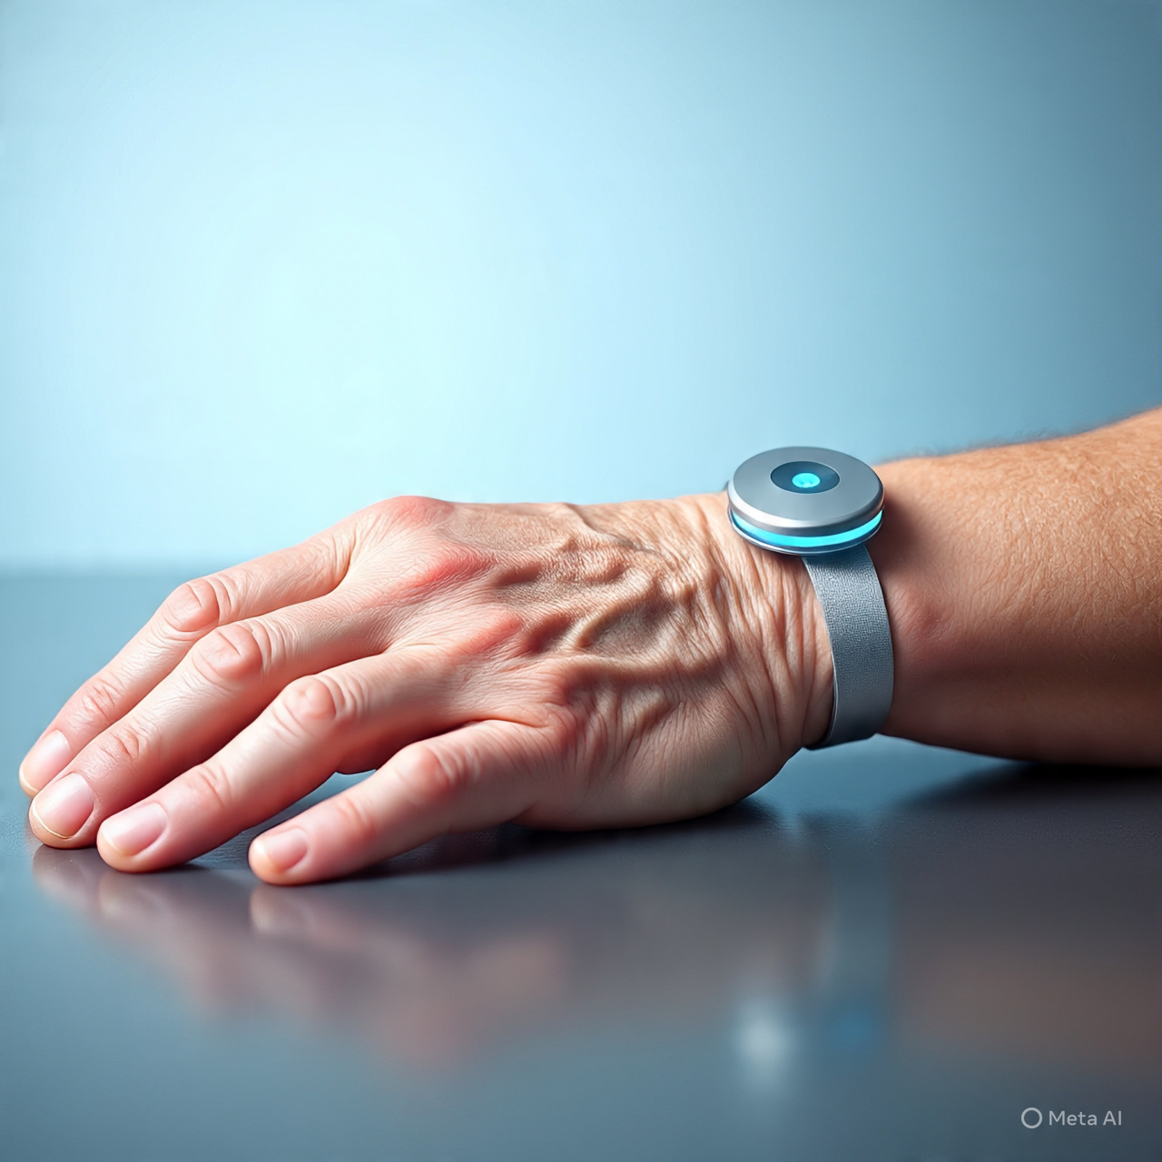
College project about Electrochemical biosensor
Robotic Arm:-
In our college Mechatronic department student develop a robotic arm which helps to disabled people by there hand from birth or any accident.This arm perform some basic work which essential in our day to day life.
- Reference by prof.Kulkarni.
Department Of Electrical Engineering, Sanjivani COE, Kopargaon

Slide 9
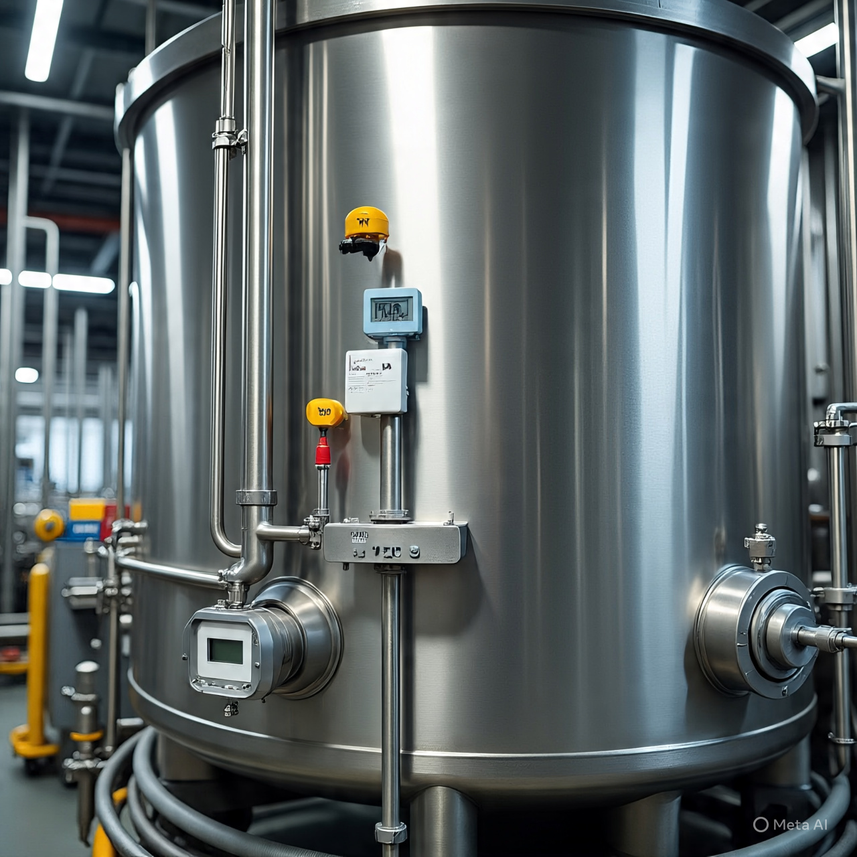
College project about Electrochemical biosensor
2) Fermentation Tank by using Sensor:-
Our college last year student Ashish Kokate develop a fermentation tank by using Electrochemical biosensor in this project he measure PH , Moisture, humidity, temperature,gas using sensors and develop a perfect condition for fermentation. It helps to produce good quality biofertilizer in minimum time.
Sensors Used in project
1.MQ-6 (Gas sensor)
2.FC-28 (Moisture sensor)
3.(pH sensor)
4.DHT-11 (humidity and temperature sensor)
Department Of Electrical Engineering, Sanjivani COE, Kopargaon

Slide 10
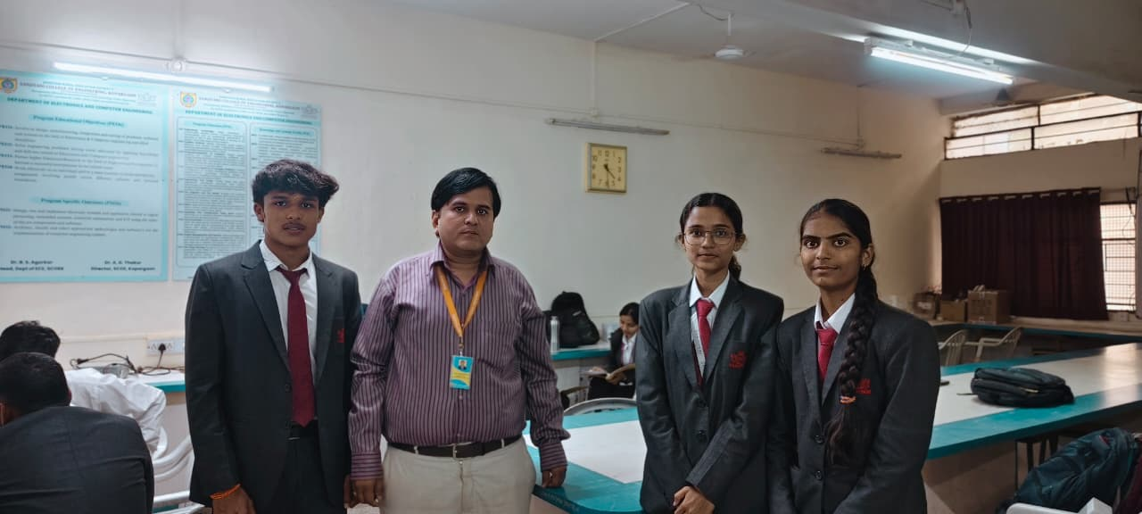
Field Visit
-Guide by:-Prof. Gupta
Department Of Electrical Engineering, Sanjivani COE, Kopargaon

Slide 11

ADAVANTAGE
High Sensitivity:-Can detect very low concentrations of target molecules.
Specificity:-Uses selective bioreceptors for accurate detection.
Rapid Response:-Provides quick results, often in real time.
Miniaturization:-Easily integrated into portable or wearable formats.
Cost-Effective:-Less expensive than traditional lab-based methods.
Department Of Electrical Engineering, Sanjivani COE, Kopargaon

Slide 12

Challenge and Limitations
1.Stability of Bioreceptor:-
Enzymes, antibodies, or DNA used as bioreceptors can degrade over time.
Environmental factors like temperature, pH, and humidity affect performance.
2.Signal Interference:-
Complex biological samples (e.g., blood, urine) contain multiple substances.
Non-specific interactions or impurities can distort the signal and reduce accuracy.
3.Limited Shelf Life:-
Biosensors often have a short operational life due to biological component degradation.
Requires careful storage and handling.
Department Of Electrical Engineering, Sanjivani COE, Kopargaon

Slide 13
Challenge and Limitations
4.Cost of Fabrication
High-quality materials (e.g., nanomaterials, noble metals) and precision manufacturing increase cost.
Scaling up for commercial production can be expensive.
5.Reproducibility Issue
Variability in sensor fabrication and biological element immobilization can lead to inconsistent results.
6.Data Interpretation Complexity
Large datasets from biosensors require advanced algorithms or machine learning for accurate analysis.
Department Of Electrical Engineering, Sanjivani COE, Kopargaon

Slide 14
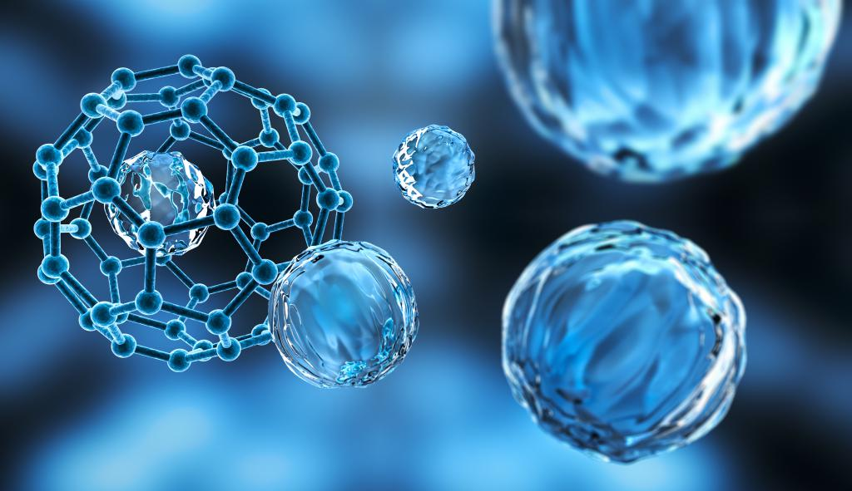
RECENT ADVANCES IN ELECTROCHEMICAL BIOSENSORS
Nanomaterials for Enhanced Sensitivity
Use of MXenes, graphene, carbon nanotubes, and metal nanoparticles to improve conductivity and surface area.
These materials enable ultra-sensitive detection of biomarkers in blood, sweat, and urine.
Smartphone Integration & IoT
Biosensors now connect with mobile apps for real-time data display and remote diagnostics.
Enables point-of-care testing and telemedicine applications.
Department Of Electrical Engineering, Sanjivani COE, Kopargaon

Slide 15

Basic Structure of Electrochemical Biosensor
1. Bioreceptor → The biological part that catches the target (e.g., enzyme, antibody, DNA, microbes).
2. Transducer → Changes this biological reaction into an electrical signal (uses electrodes).
3. Electronics → Makes the signal stronger and cleaner.
4. Display → Shows the result (on screen, mobile, etc.).
Department Of Electrical Engineering, Sanjivani COE, Kopargaon

Slide 16

SUMMARY
An electrochemical biosensor is a powerful, portable, and cost-effective tool that uses a biological recognition system and an electrochemical transducer to detect analytes in medical, environmental, food, and industrial fields.
Department Of Electrical Engineering, Sanjivani COE, Kopargaon

Slide 17

Thanks! For Your Valuable Time
Department Of Electrical Engineering, Sanjivani COE, Kopargaon

